Slide 1


FRC 6995 NOMAD
Software training 101

Slide 2
Introductions
Sharon Rigg – Software Lead Mentor
Greg Shue – Software Mentor
Jeremiah & Ben S – Returning students

Slide 3
2019 SOFTWARE TEAM Vision
My vision is to enable you, the students, to be successful in developing the software for our robot.
I will do what I can to provide the training you need to do your job. I am here to advise, but I will encourage you to work as a team and learn through trial and error.
I will help provide structure to the planning process and scheduling tasks (I am a WEST after all!).
Notes:
Sharon - I am a WEST. Sometimes I forget to be warm and fuzzy when dealing with tasks.

Slide 4
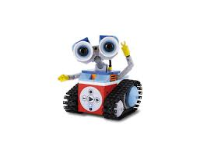
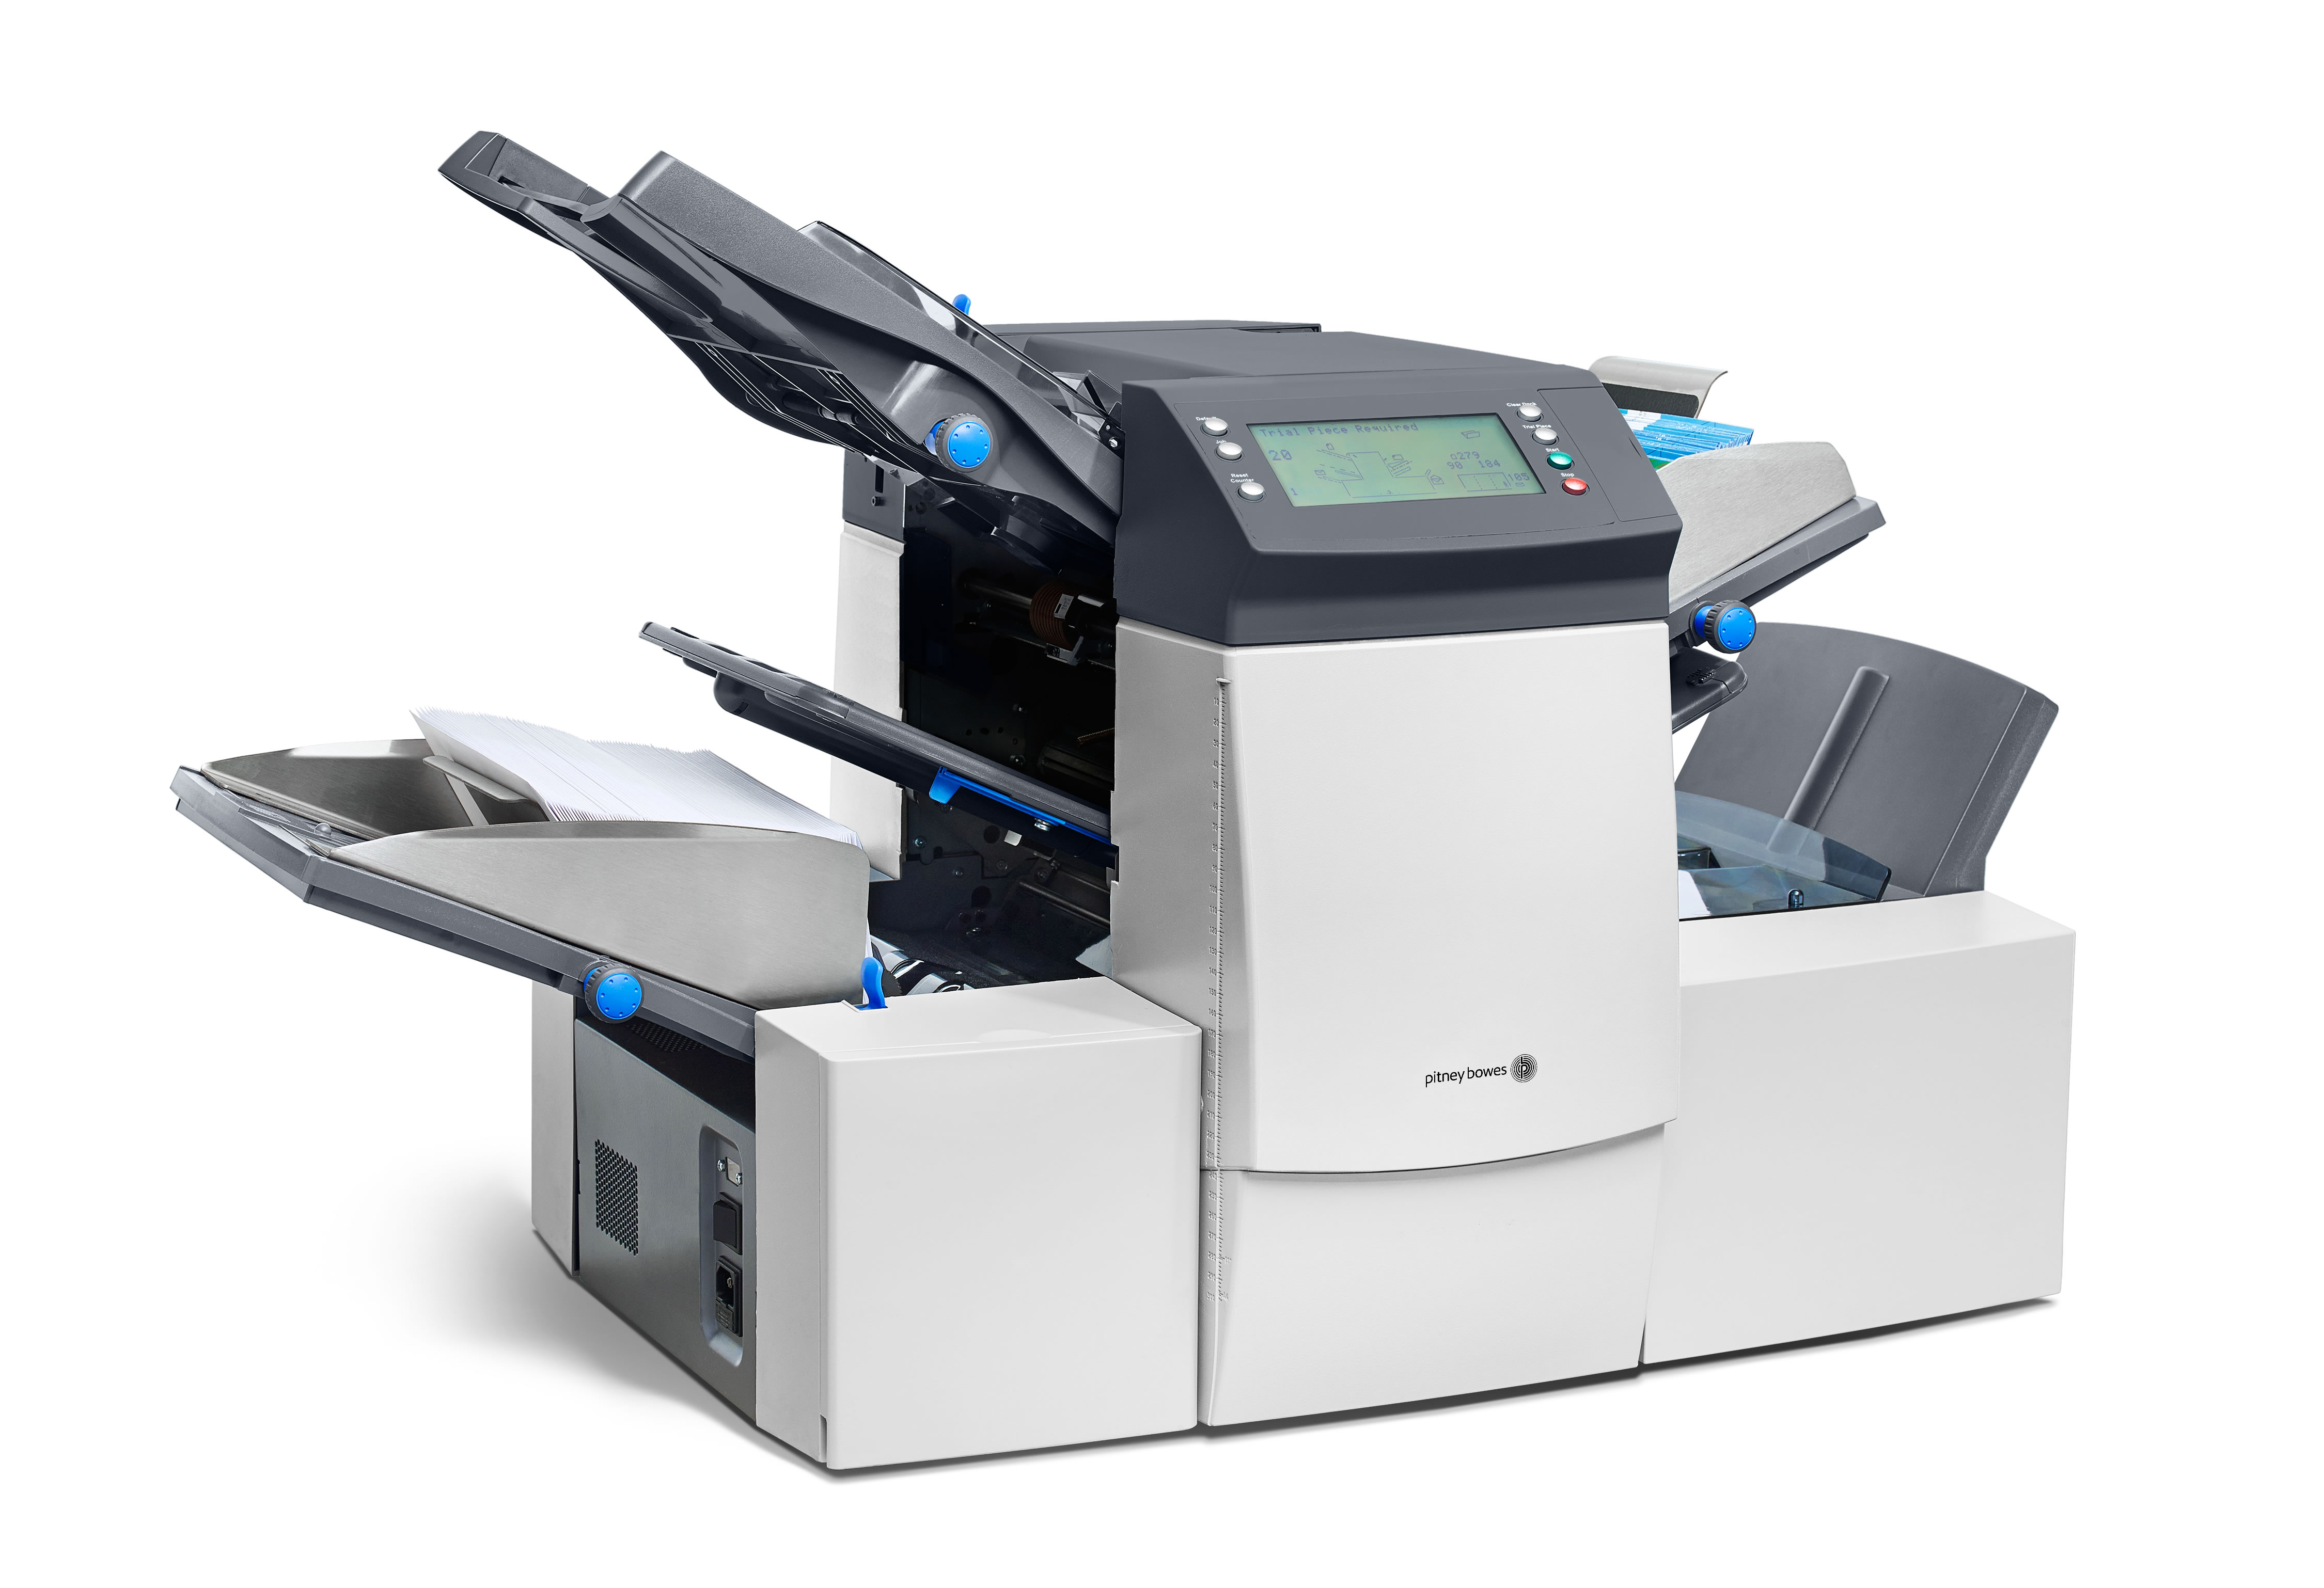
How are robots different than machines?
Notes:
Sharon - I am a WEST. Sometimes I forget to be warm and fuzzy when dealing with tasks.

Slide 5
How are robots different than machines?
Machines can precisely repeat predetermined motions automatically (like a washing machine or dishwasher).
Robots can perform tasks either automatically or by remote control.
Notes:
Sharon - I am a WEST. Sometimes I forget to be warm and fuzzy when dealing with tasks.

Slide 6
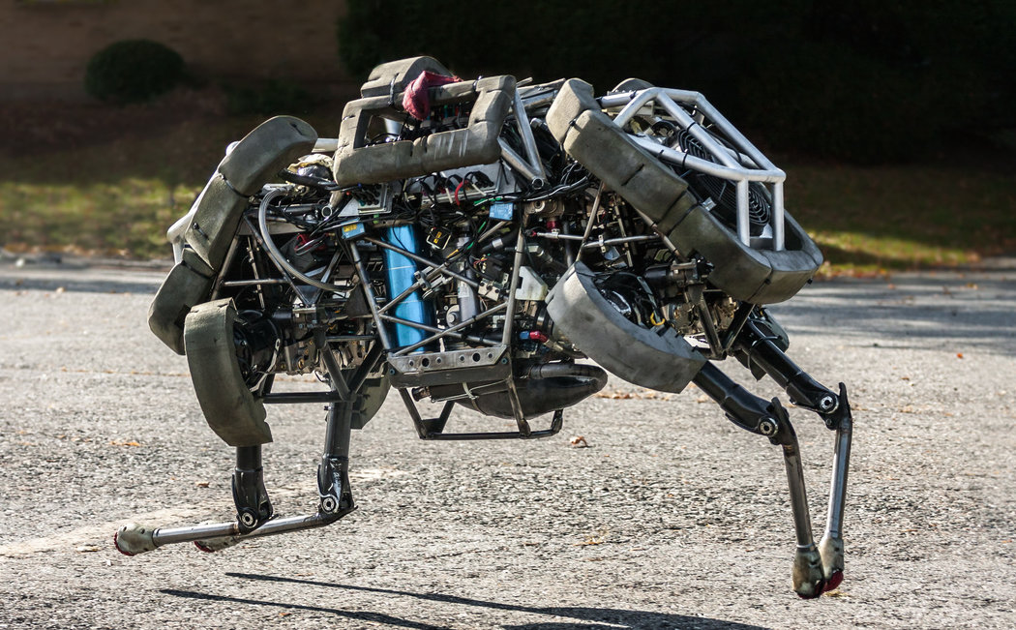
How are robots used today?
Notes:
Sharon - I am a WEST. Sometimes I forget to be warm and fuzzy when dealing with tasks.

Slide 7
How are robots used today?
Retrieve bombs
Build things like cars, candy bars, and electronics.
Used in medicine
Military tactics
Finding objects underwater
Explore other planets.
Notes:
Sharon - I am a WEST. Sometimes I forget to be warm and fuzzy when dealing with tasks.

Slide 8

Parts of a robot
Most robots are composed of 3 main parts:
The Controller ‐ also known as the "brain" which is run by a computer program. Often, the program is very detailed as it gives commands for the moving parts of the robot to follow.
Mechanical Parts ‐ motors, pistons, grippers, wheels, and gears that make the robot move, grab, turn, and lift. These parts are usually powered by air, water, or electricity.
Sensors ‐ to tell the robot about its surroundings. Sensors allow the robot to determine sizes, shapes, space between objects, direction, and other relations and properties of substances. Many robots can even identify the amount of pressure necessary to apply to grab an item without crushing it.
Notes:
Sharon - I am a WEST. Sometimes I forget to be warm and fuzzy when dealing with tasks.

Slide 9
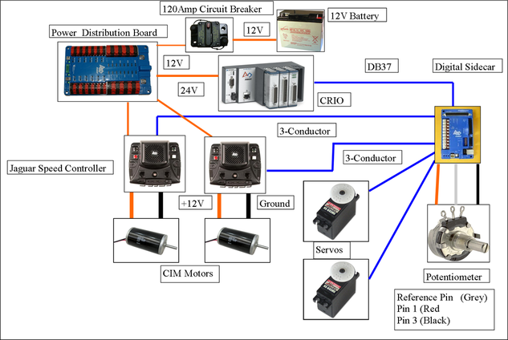
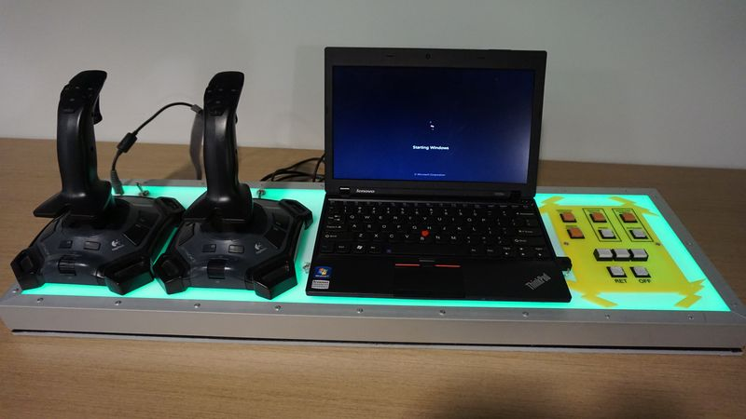
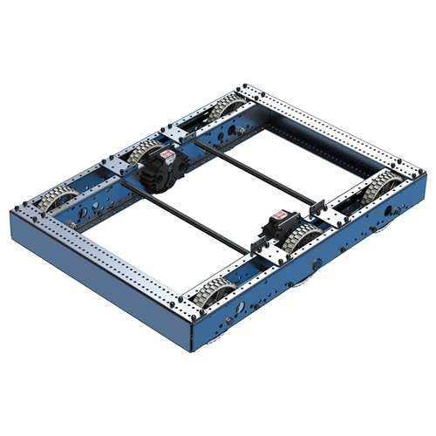
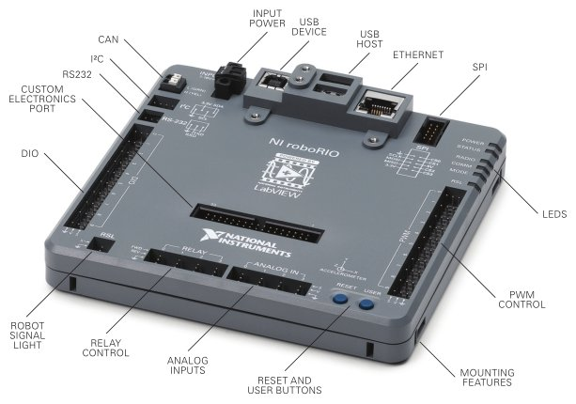
The FRC robot
Electronics
Gathers information or causes
mechanics to move.
Includes Limit Switches, Encoders,
NavX, Spark, Talon, CIM,
Solenoid, and more
Driver Station
Joystick, PC running Smart Dashboard
Robot
roboRIO (brain)
Sends and receives information to/from the Electronics.
Notes:
Sharon - I am a WEST. Sometimes I forget to be warm and fuzzy when dealing with tasks.

Slide 10
What does the software team work on?
The software team will work directly with the brain of the robot
In FRC, the controller/brain of the robot is the roboRIO (a mini computer)
The code we write is transferred to the roboRIO.
We must also have knowledge of the electrical and mechanical parts of the robot.
Notes:
Sharon - I am a WEST. Sometimes I forget to be warm and fuzzy when dealing with tasks.

Slide 11
Operation modes
Autonomous – first 15 seconds of a match. – The robot moves only by preset instructions (like a machine), no user interaction.
Teleop – Drivers control the robot through use of external devices like a joystick.
Disable – Robot is disabled
Practice – This can be used to test out specific code or to run commands before a match starts (like charging up pneumatics).
Notes:
Sharon - I am a WEST. Sometimes I forget to be warm and fuzzy when dealing with tasks.

Slide 12
Software terminology - IDE
IDE (Integrated Development Environment) –
An IDE is a software suite that consolidates basic tools required to write and test software such as
Text editors,
Code libraries
Compilers
Test platforms
The integrated toolset is designed to simplify software development and can identify and minimize coding mistakes and typos.
In 2018 we used Eclipse. In 2019 we will switch to Visual Studio Code (https://wpilib.screenstepslive.com/s/currentCS/m/79833/l/932382-installing-vs-code)
Notes:
Sharon - I am a WEST. Sometimes I forget to be warm and fuzzy when dealing with tasks.

Slide 13

Software terminology - java
Java is an object-oriented programming language
Java code can run on all platforms that support Java without the need for recompilation.
It compiles to bytecode that can run on any Java virtual machine (JVM) regardless of computer architecture.
FRC Teams also have a choice of programming in LabView or C++.
Notes:
Sharon - I am a WEST. Sometimes I forget to be warm and fuzzy when dealing with tasks.

Slide 14
Software terminology – COMMAND BASED
Our robot is programmed as a command based robot.
A command based robot has the following types of classes:
Subsystems classes – Subsystems break the robot into smaller parts. Each subsystem defines what the subsystem is made of and what that part of the robot can do.
Drive Train can move forward, backward and stop
Lifter can move up or down
Grabber can open or close
Command classes – Commands tell the robot to perform the actions
Notes:
Sharon - I am a WEST. Sometimes I forget to be warm and fuzzy when dealing with tasks.

Slide 15
Software terminology - WPILib
WPILib is a robotics software library used in the FIRST Robotics Competition
It was initially developed by WPI professor Brad Miller as a way to simplify program development for the FRC robot control system.
It contains software that handles lower level details of the hardware (interrupt routines, voltage measurements and conversions, communications details, etc.) so students can focus on solving higher level problems.
https://www.firstinspires.org/robotics/frc/blog/2019-wpilib
Notes:
Sharon - I am a WEST. Sometimes I forget to be warm and fuzzy when dealing with tasks.

Slide 16
Software DEVELOPMENT IN A NUTSHELL
Write Java code in an IDE
Compile Code
Transfer code to roboRIO (via cable or radio signal)
Test code on robot
Upload changes to GitHub (more on that later)
Notes:
Sharon - I am a WEST. Sometimes I forget to be warm and fuzzy when dealing with tasks.

Slide 17



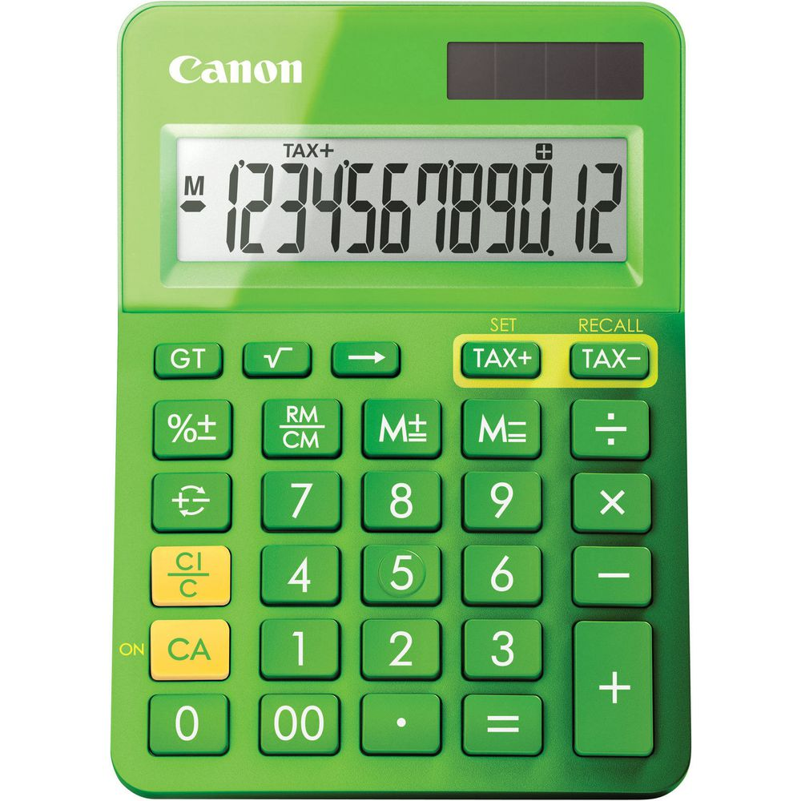

Role Playing Exercise
Notes:
Sharon - I am a WEST. Sometimes I forget to be warm and fuzzy when dealing with tasks.

Slide 18
Role Playing Exercise - Classes
Acrobat
Dice
Blackboard
Calculator
Bamboozler
LazyCalculator
Decider
Notes:
Sharon - I am a WEST. Sometimes I forget to be warm and fuzzy when dealing with tasks.

Slide 19
Role Playing Exercise - METHODS
Acrobat – clap(x), kneeBend(x), count
Dice – roll(x), numRolls(x), reset
Blackboard – drawCircle, drawSquare, drawText(text), clear
Calculator – add(x,x), subtract(x,x), multiply(x,x)
Bamboozler - add(x,x), subtract(x,x),
LazyCalculator – add(x,x), add(x,x,x,x)
Decider – dayOfWeek(date), rate(text)
Notes:
Sharon - I am a WEST. Sometimes I forget to be warm and fuzzy when dealing with tasks.

Slide 20
Role Playing Exercise - object
?? is a class type of Acrobat
?? is a class type of Dice
?? and ?? is a class type of Blackboard
?? is a class type of Calculator
?? is a class type of Bamboozler
?? is a class type of LazyCalculator
?? is a class type of Decider
Notes:
Sharon - I am a WEST. Sometimes I forget to be warm and fuzzy when dealing with tasks.

Slide 21
Role Playing Exercise - COMMANDS
clap
kneebends
count
tripleBackFlip
roll
numRolls
drawSquare
drawCircle
drawText
clear
add
subtract
multiply
dayOfWeek
rate
Notes:
Sharon - I am a WEST. Sometimes I forget to be warm and fuzzy when dealing with tasks.

Slide 22
Role Playing Exercise
Java syntax for giving commands to (or requesting service from) an object:
<acrobat>.clap(3)
<dice>.roll()
<calculator>.add(10, 4)
<Decider>.rate(“Ginger Spice”)
Notes:
Sharon - I am a WEST. Sometimes I forget to be warm and fuzzy when dealing with tasks.

